Slide 1
DevOps definition
DevOps is a methodology in the software development and IT industry.
Used as a set of practices and tools, DevOps integrates and automates the work of software development (Dev) and IT operations (Ops) as a means for improving and shortening the systems development life cycle. DevOps is complementary to agile software development; several DevOps aspects came from the agile way of working.
https://en.wikipedia.org/wiki/DevOps

Slide 2



The Purpose of DevOps
Developers needs:
Environment(s) and Infrastructure for Developing
Quality assurance needs:
Environment and Infrastructure for Testing
Automated testing
Monitoring system and application health
Project Manager needs:
Faster time to market
DevOps solutions for team collaboration
Automated deployment and configuration

Slide 3
DevOps Instruments
Infrastructure as code: Ansible, Terraform, Puppet, Chef
CI/CD: Jenkins, TeamCity, Shippable, Bamboo, Azure DevOps
Test automation: Selenium, Cucumber, Apache JMeter
Containerization: Docker, Rocket, Unik
Orchestration: Kubernetes, Swarm, Mesos
Software deployment: Elastic Beanstalk, Octopus, Vamp
Measurement: Datadog, DynaTrace, Kibana, NewRelic, ServiceNow
ChatOps: Hubot, Lita, Cog

Slide 4
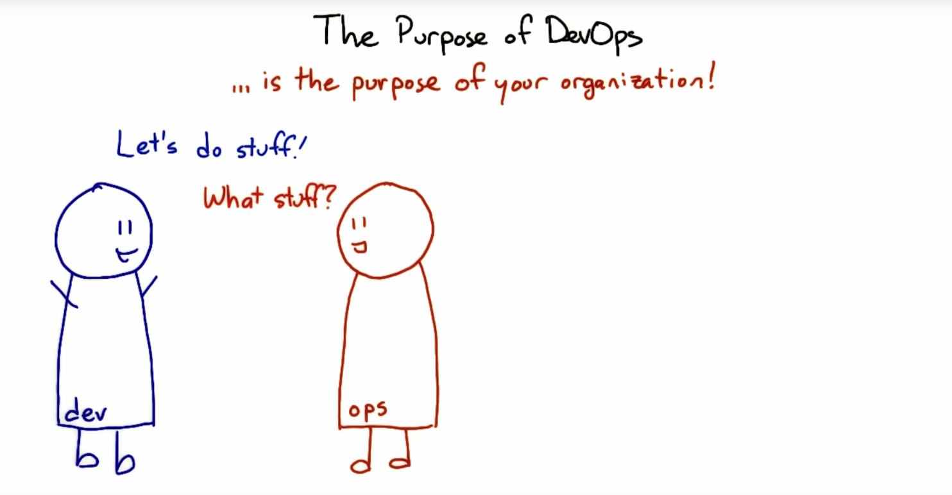
https://classroom.udacity.com/courses/ud611/
Notes:
1

Slide 5
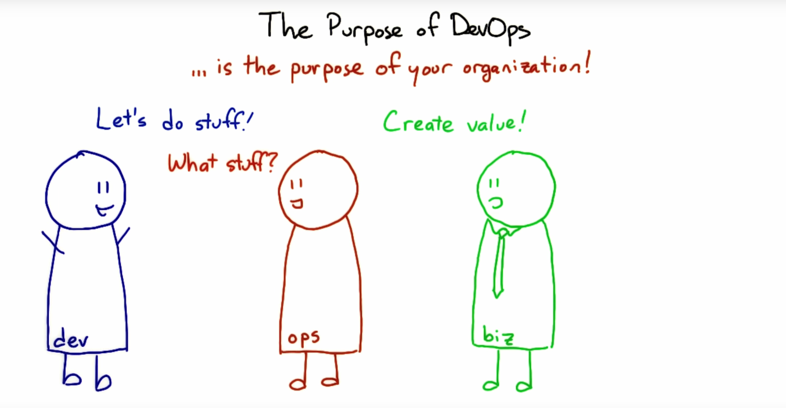
Notes:
1

Slide 6
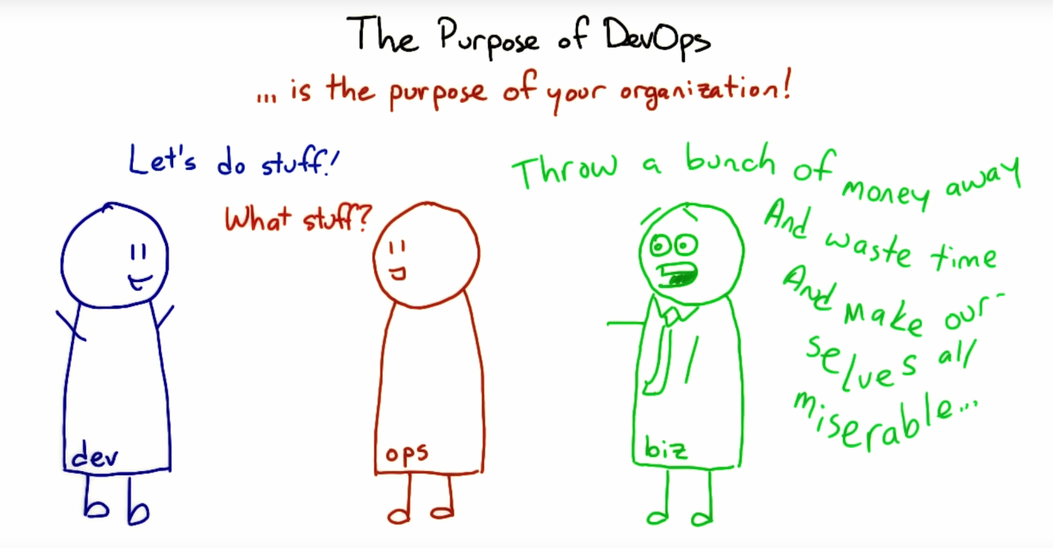
Notes:
1

Slide 7
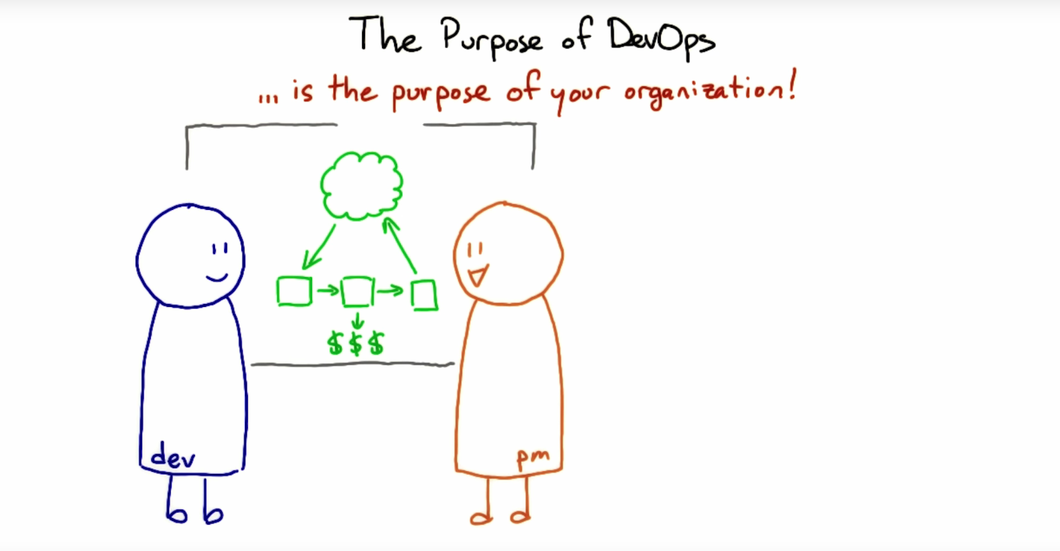
Notes:
1

Slide 8
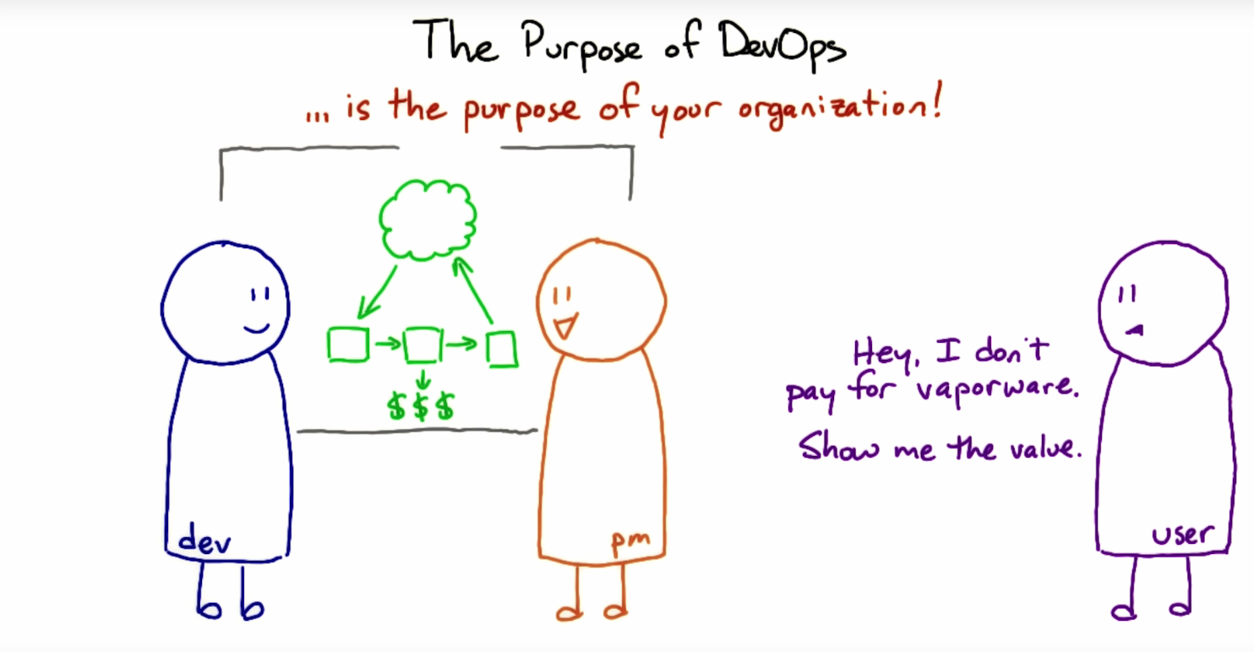
Notes:
1

Slide 9
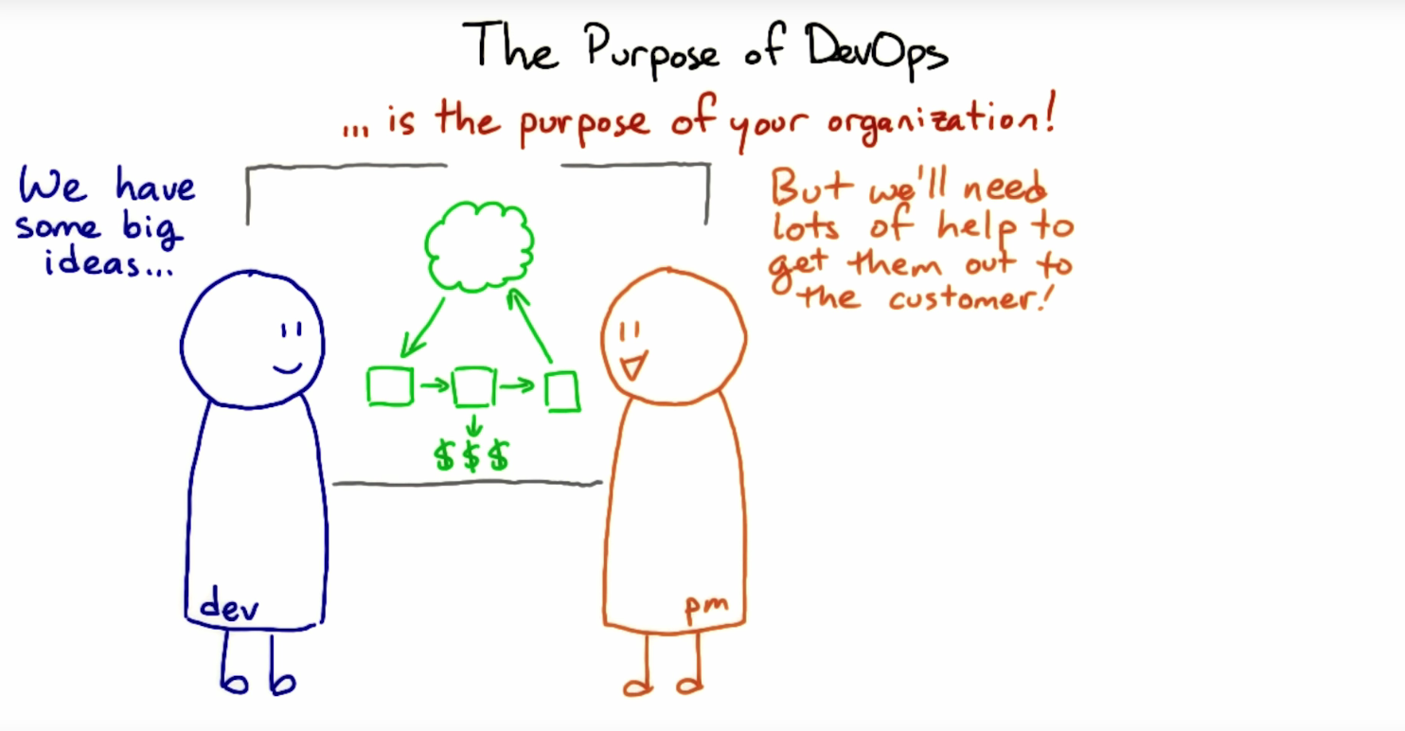
Notes:
1

Slide 10
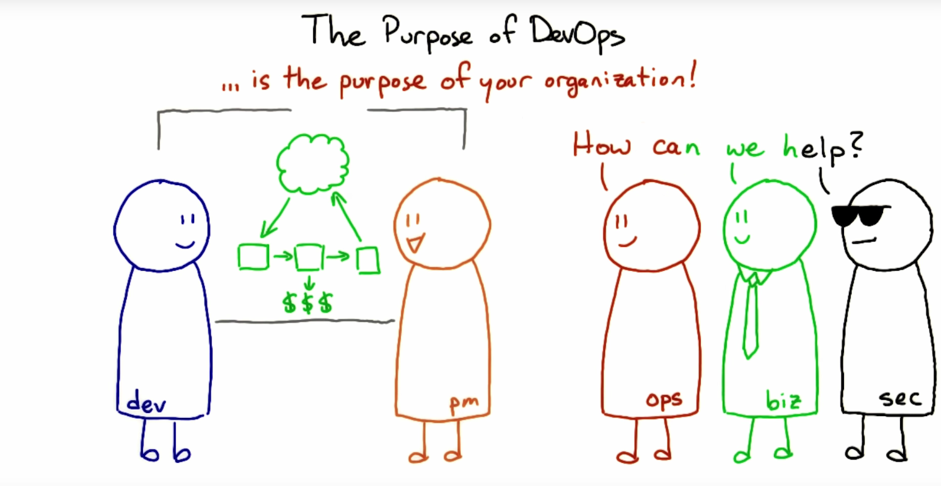
Notes:
1

Slide 11
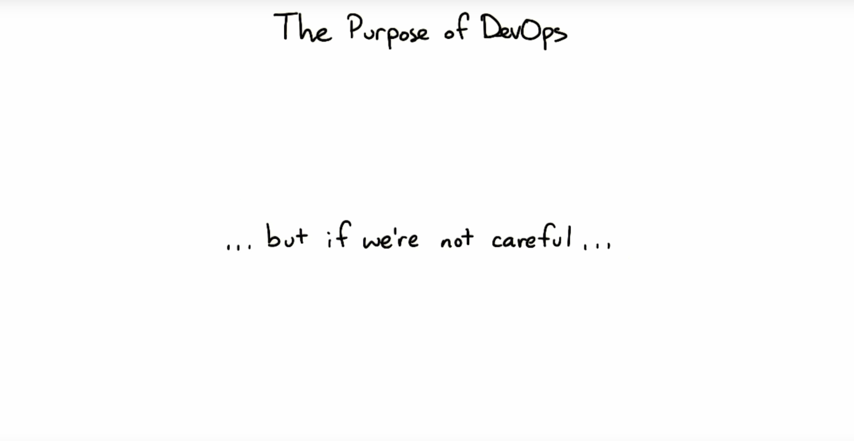
Notes:
1

Slide 12
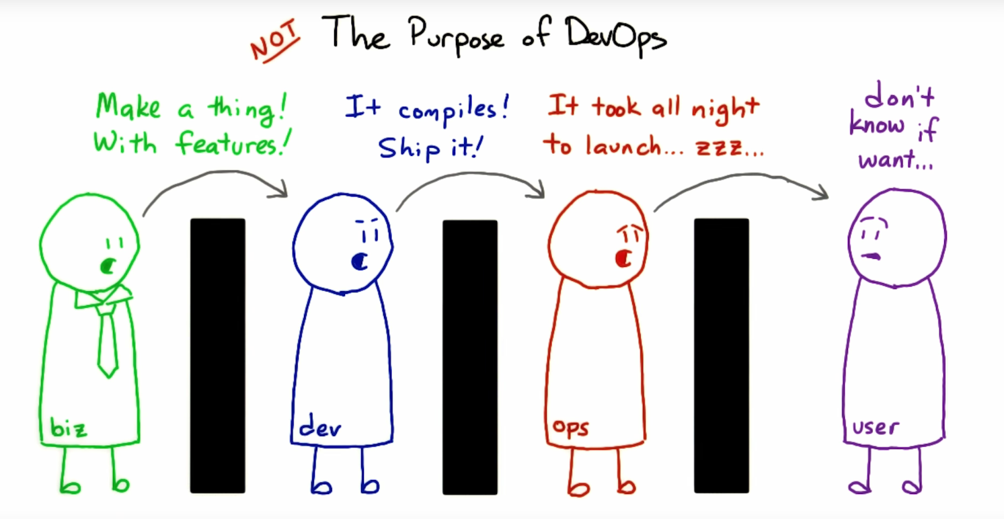
Notes:
1

Slide 13
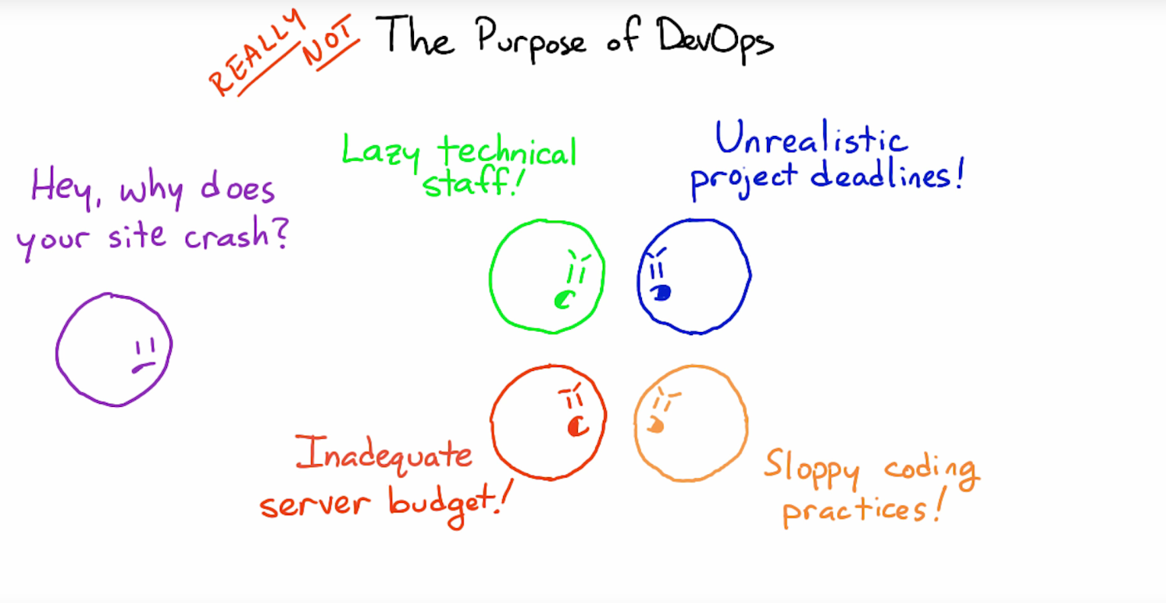
Notes:
1

Slide 14
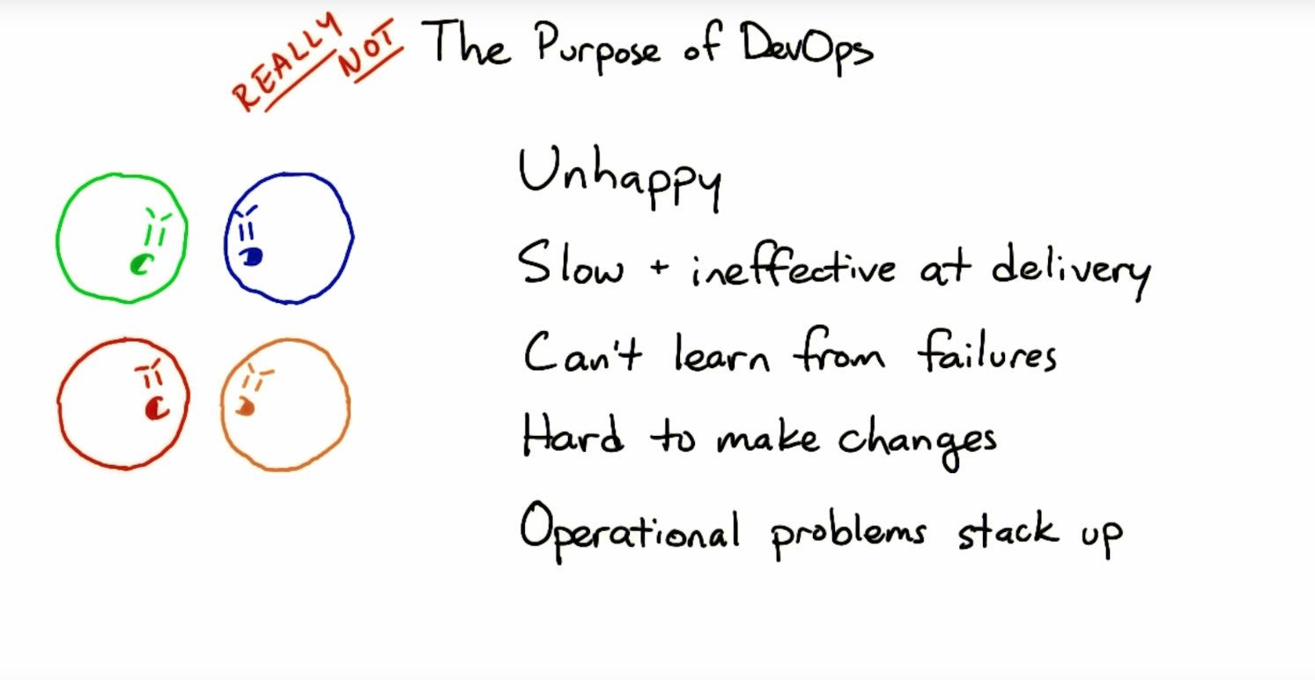
Notes:
1

Slide 15
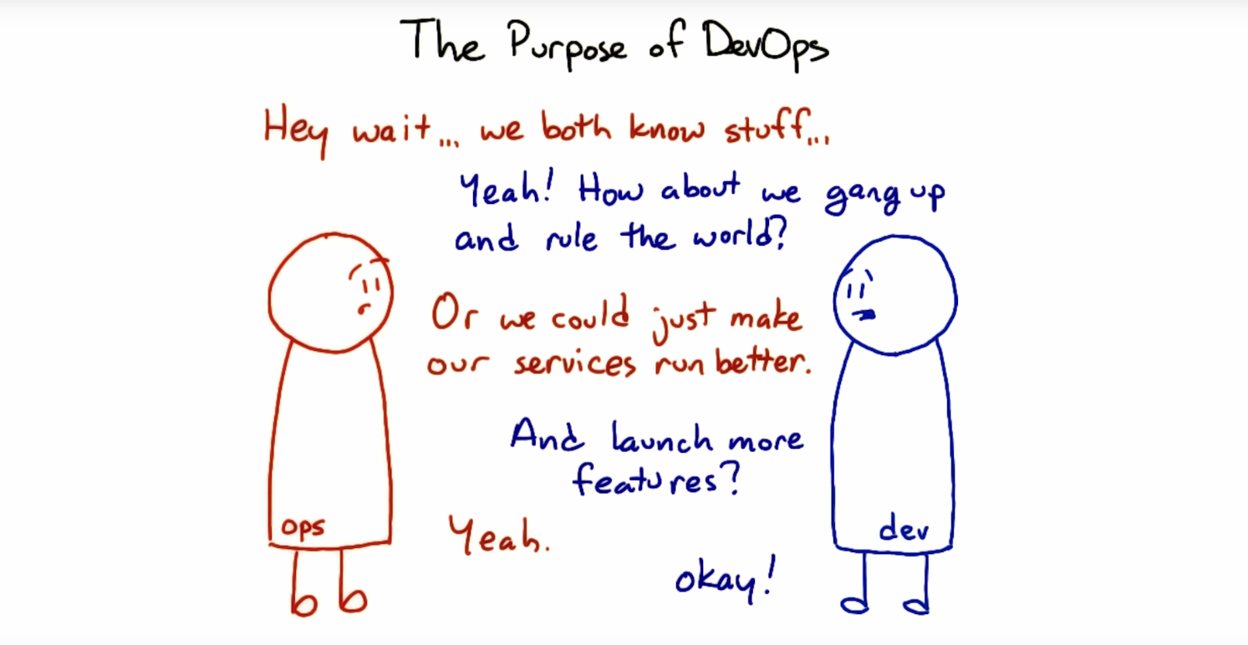
Notes:
1

Slide 16
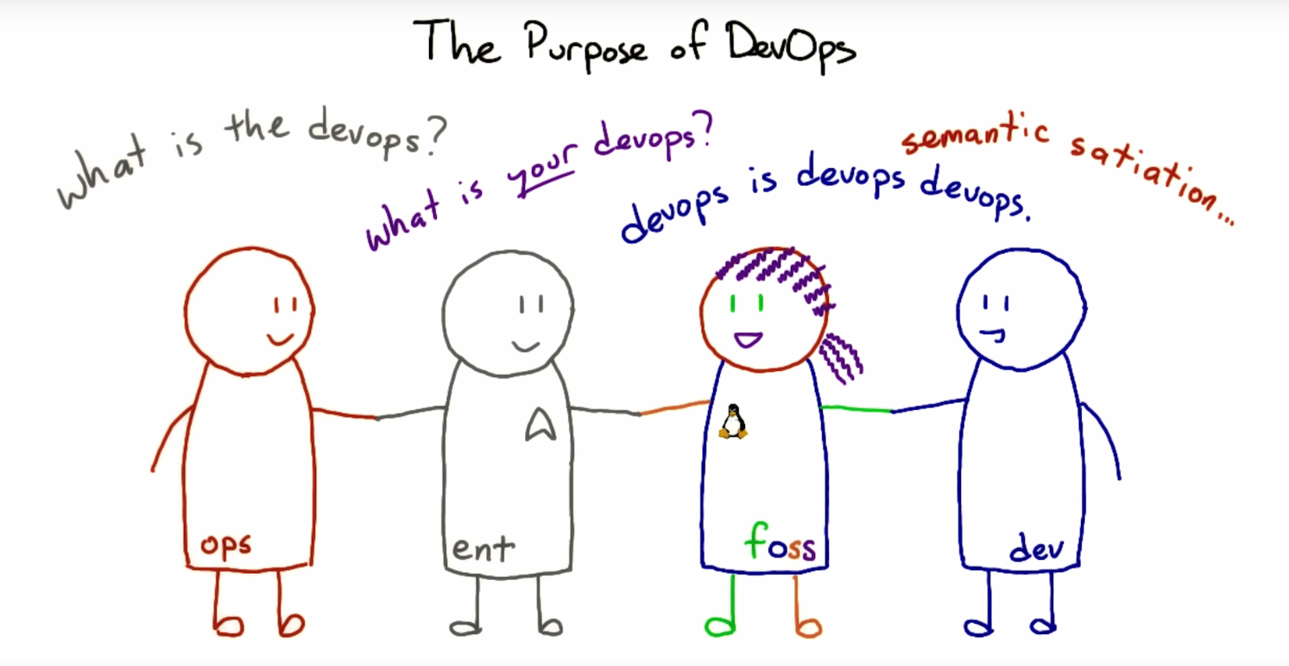
Notes:
1

Slide 17
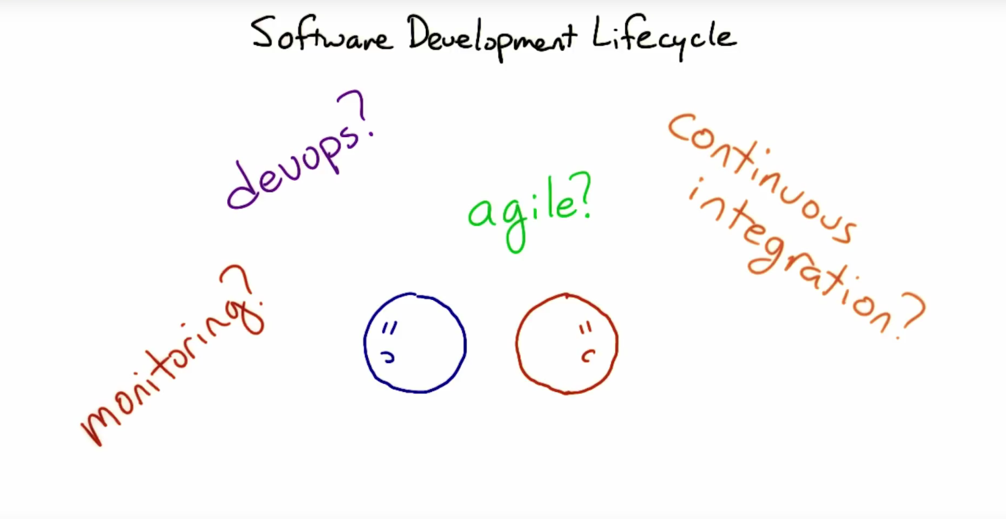
Notes:
1

Slide 18
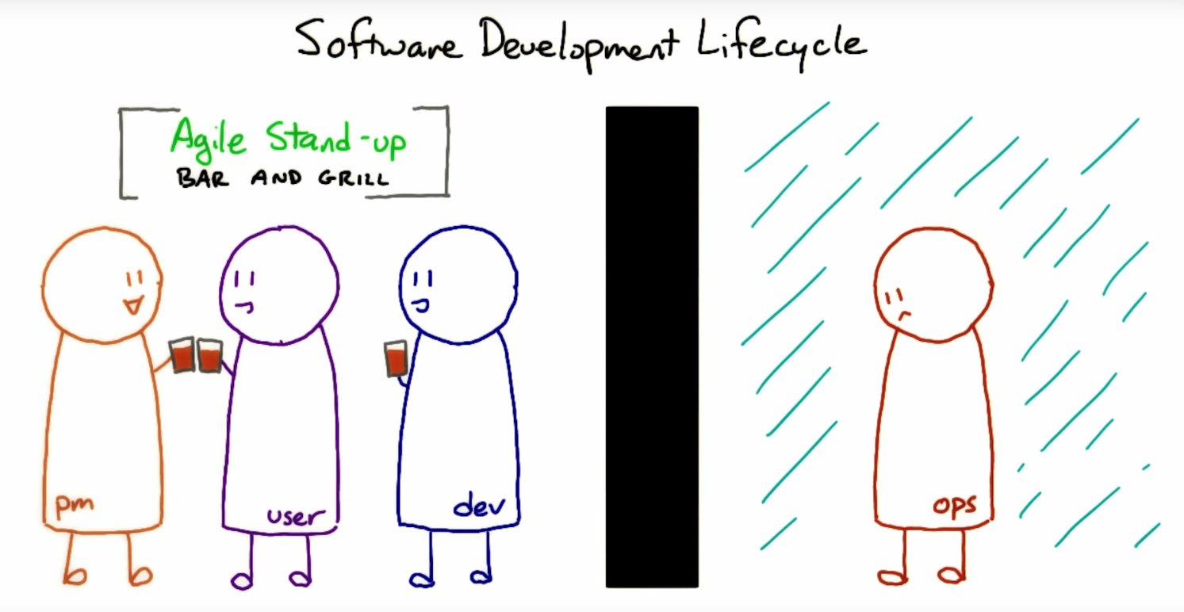
Notes:
1

Slide 19
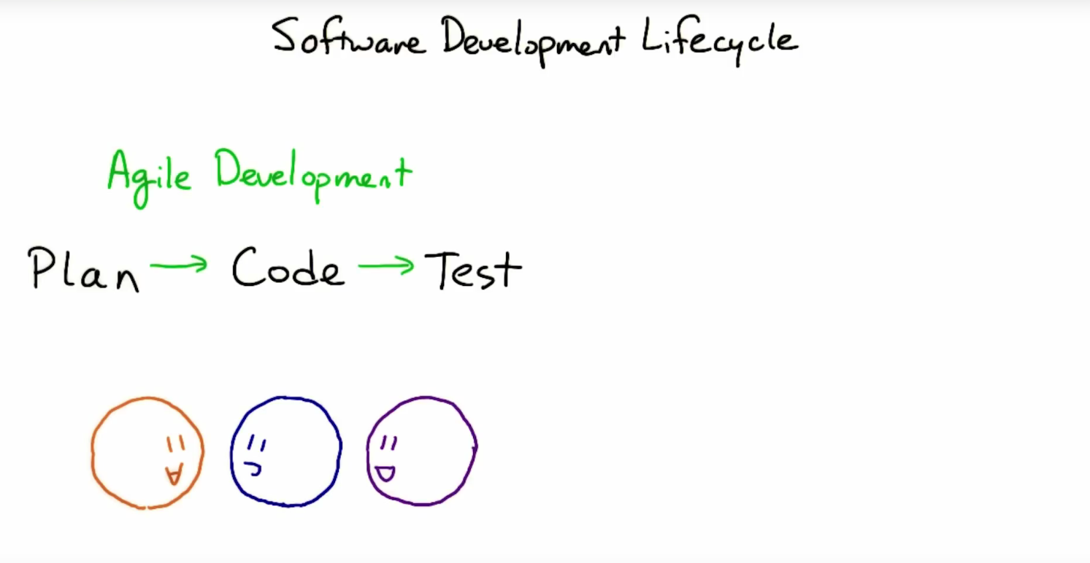
Notes:
1

Slide 20
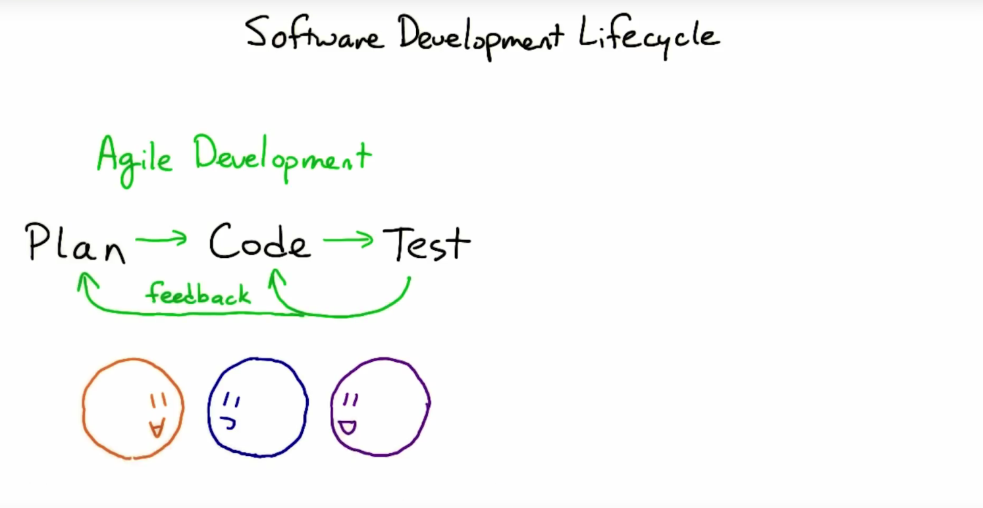
Notes:
1

Slide 21
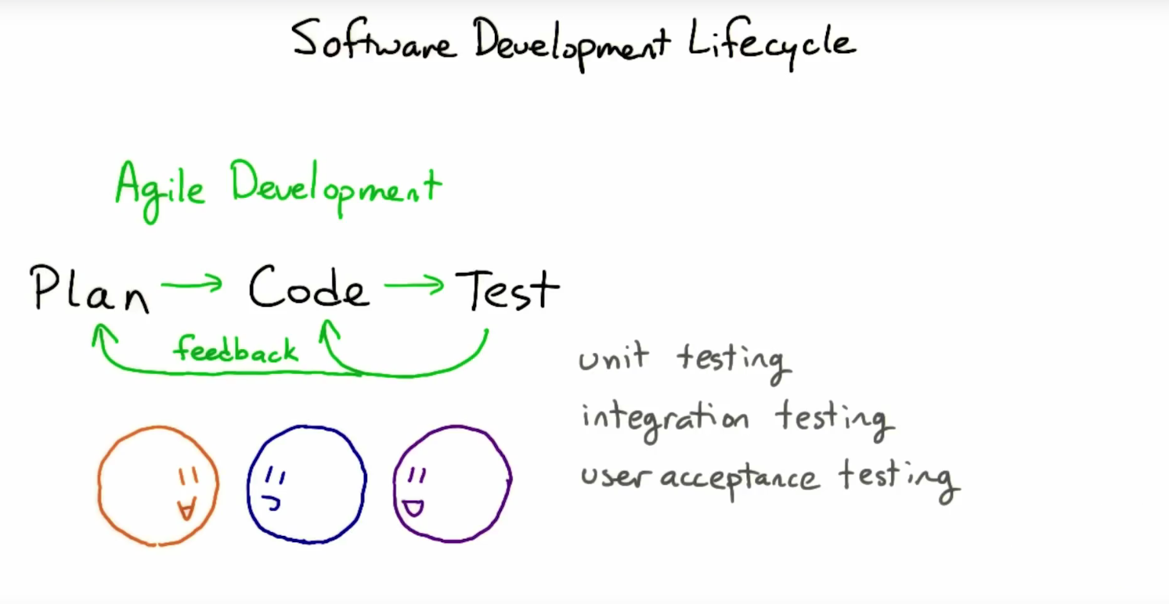
Notes:
1

Slide 22
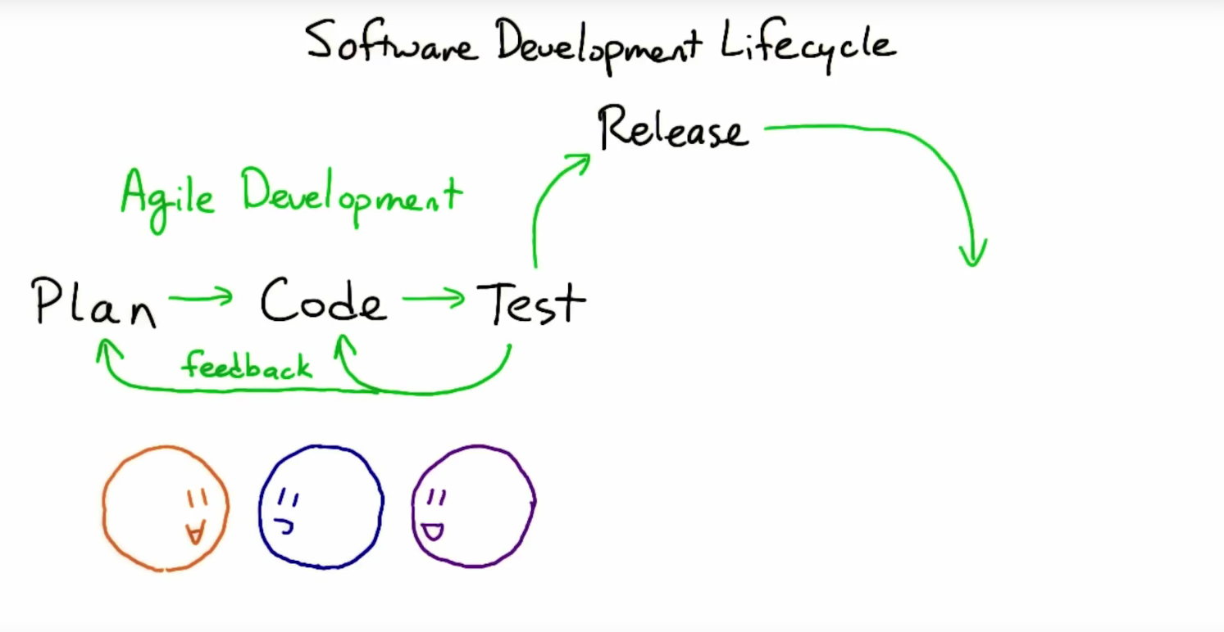
Notes:
1

Slide 23
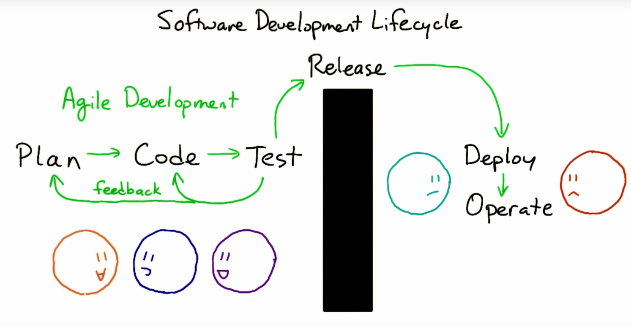
Notes:
1

Slide 24
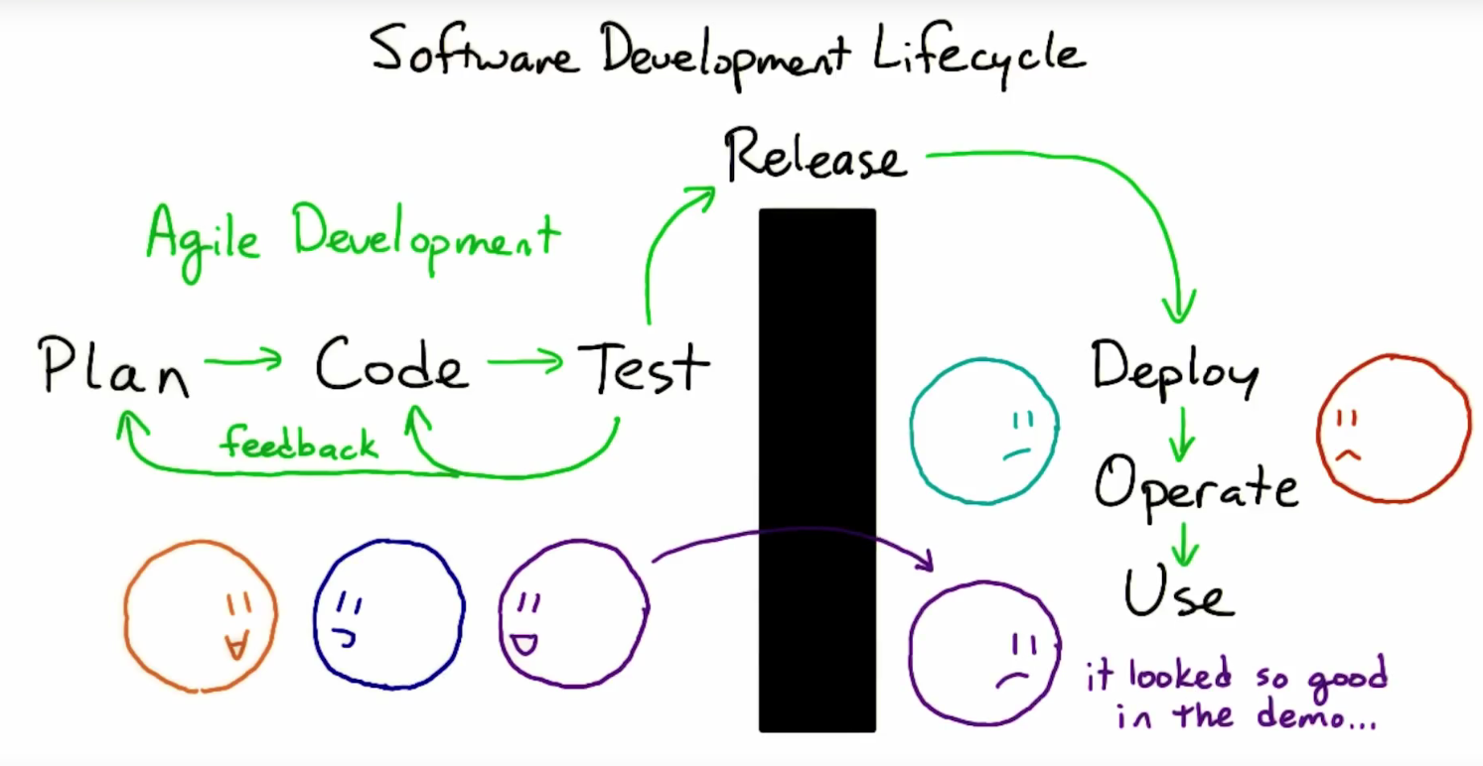
Notes:
1

Slide 25
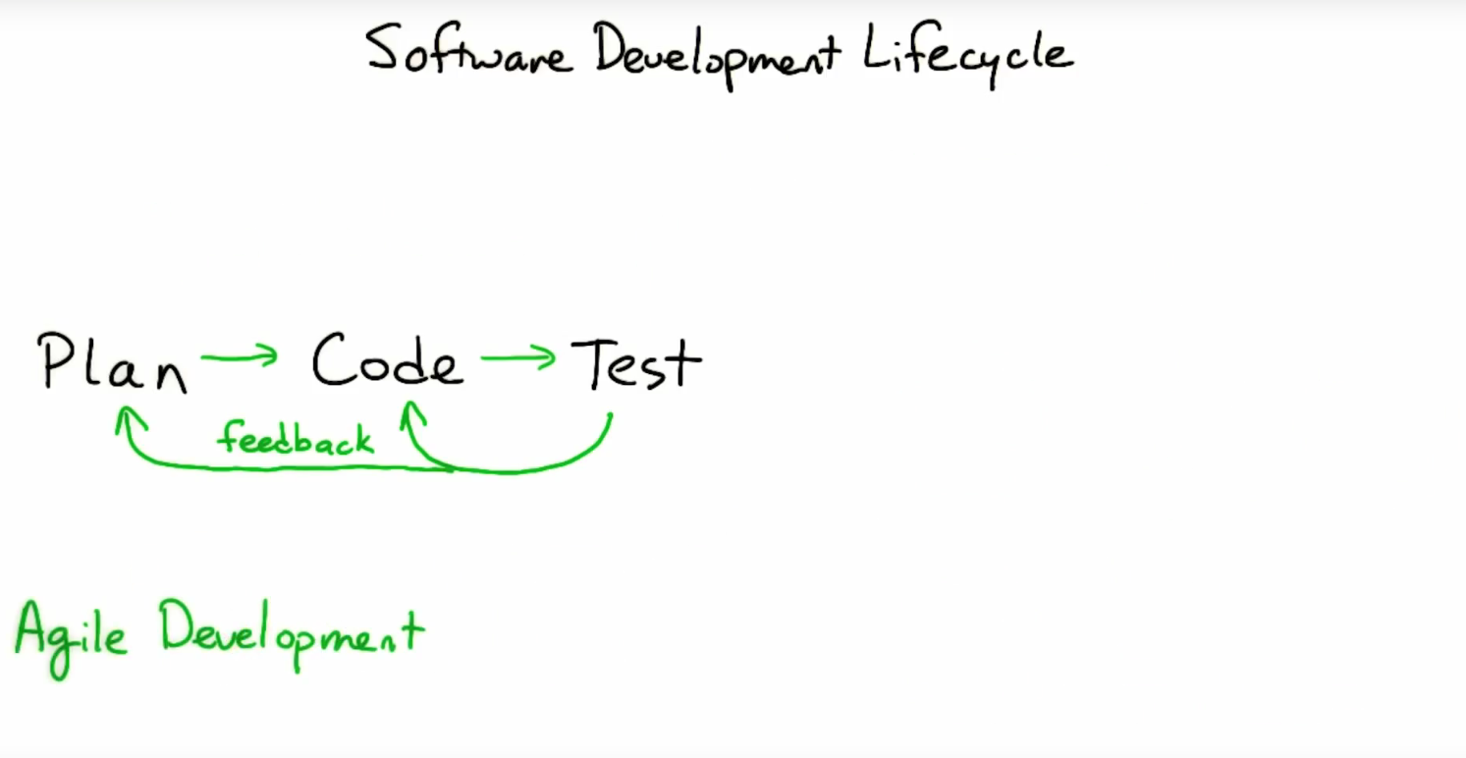
Notes:
1

Slide 26
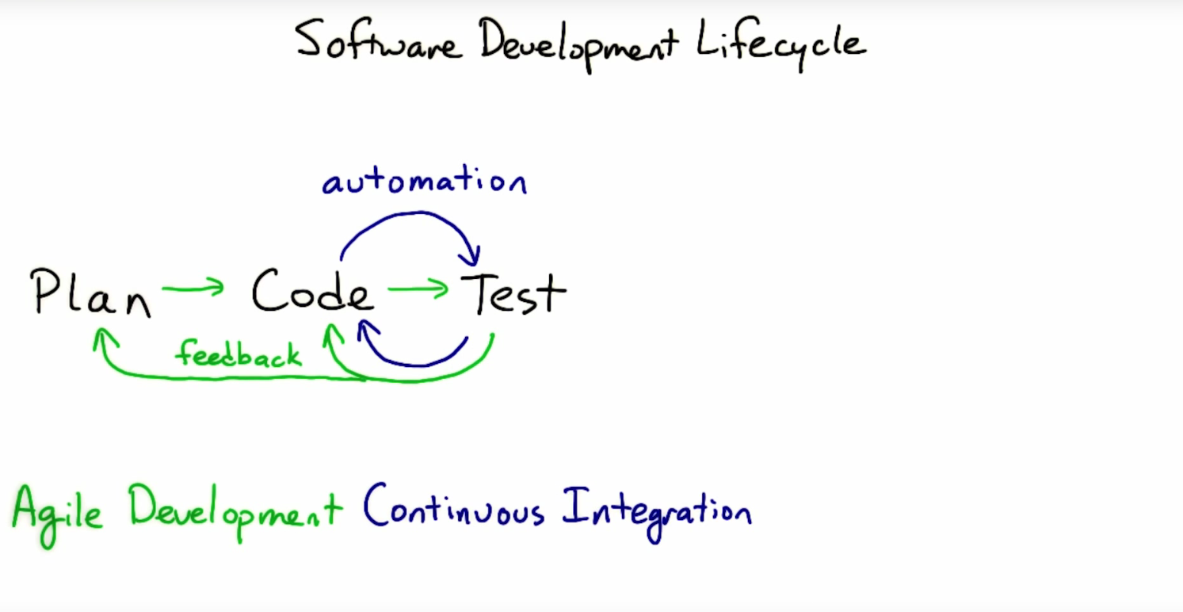
Notes:
1

Slide 27
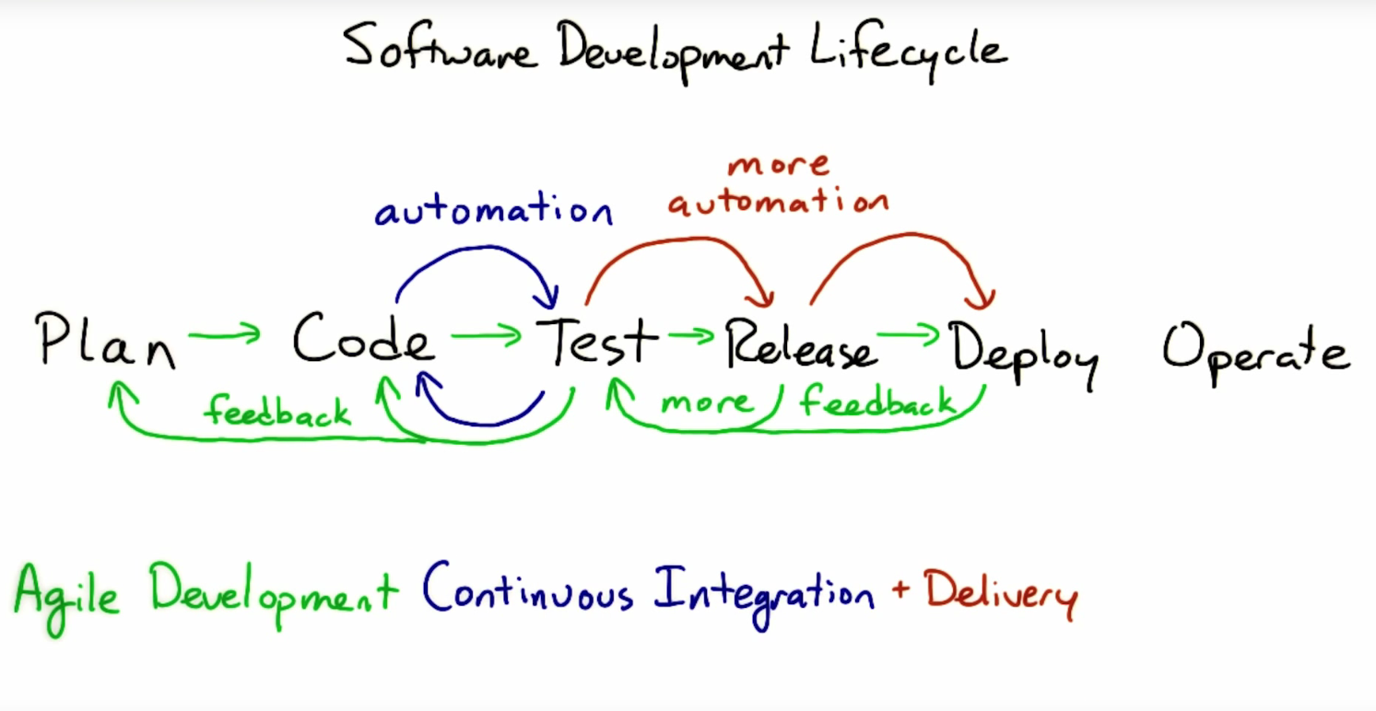
Notes:
1

Slide 28
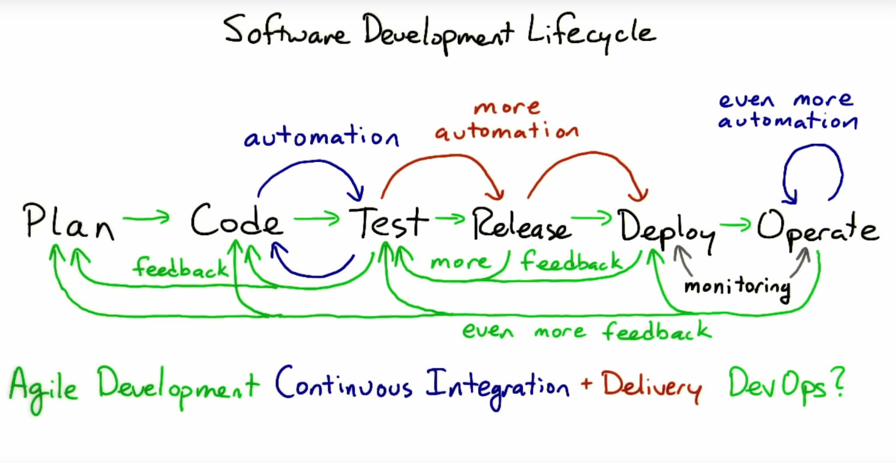
Notes:
1

Slide 29
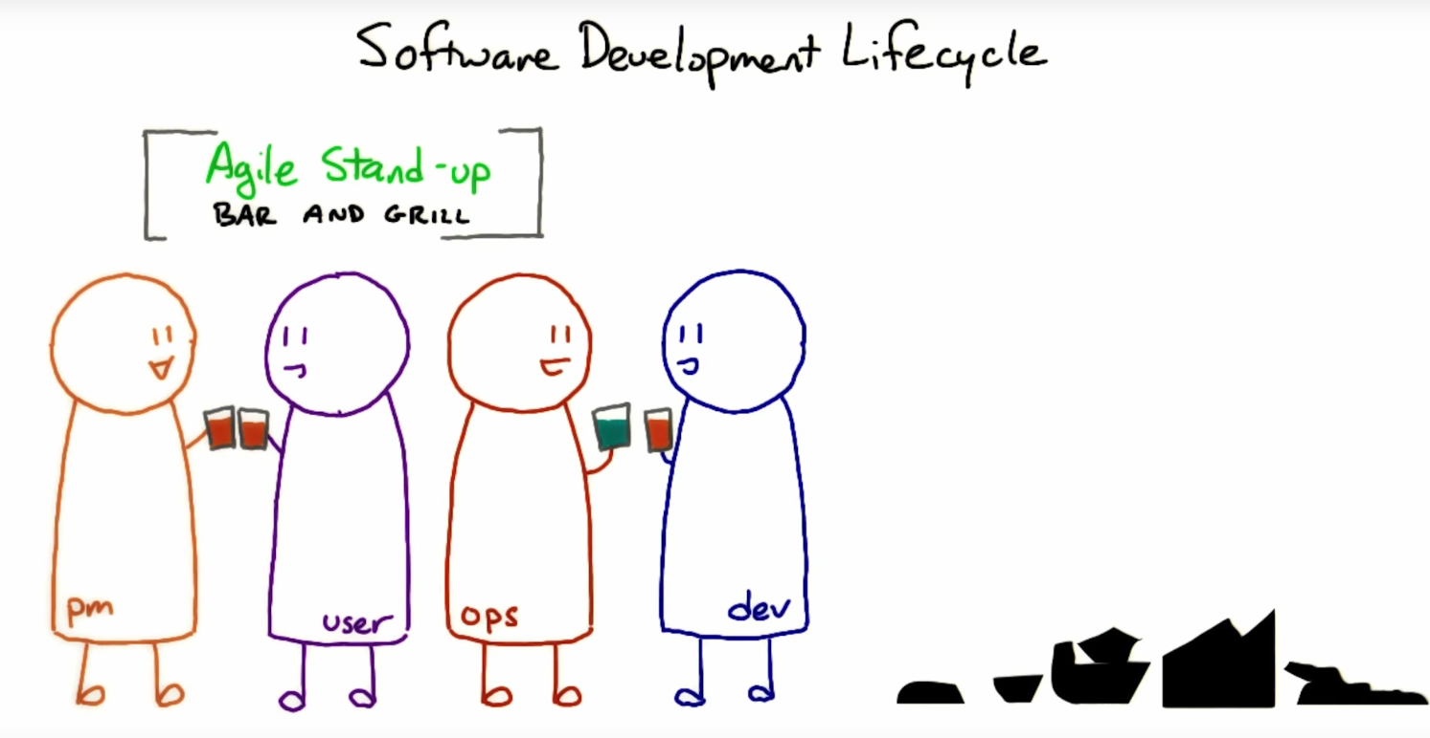
Notes:
1

Slide 30
The Purpose of DevOps
Examples

Slide 31
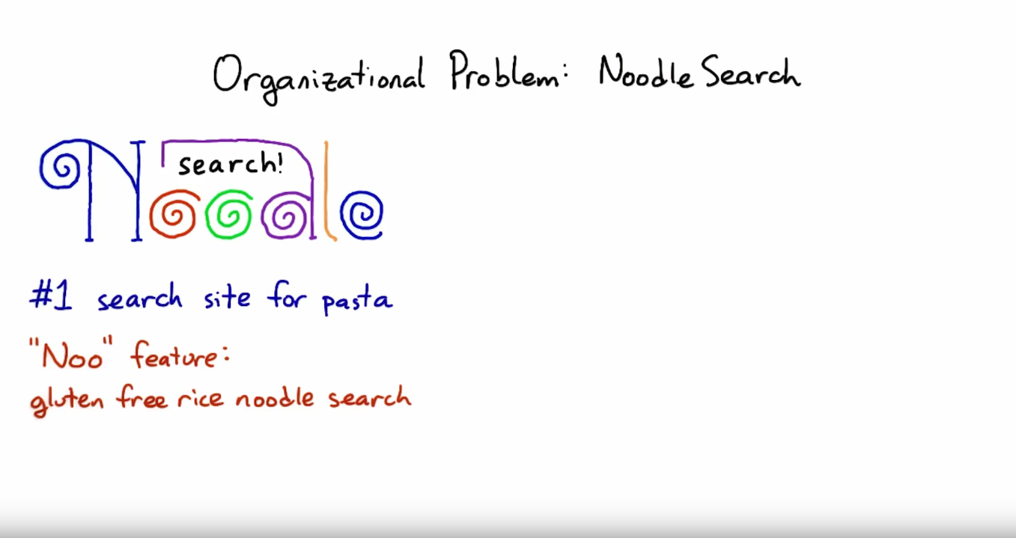
Notes:
1

Slide 32
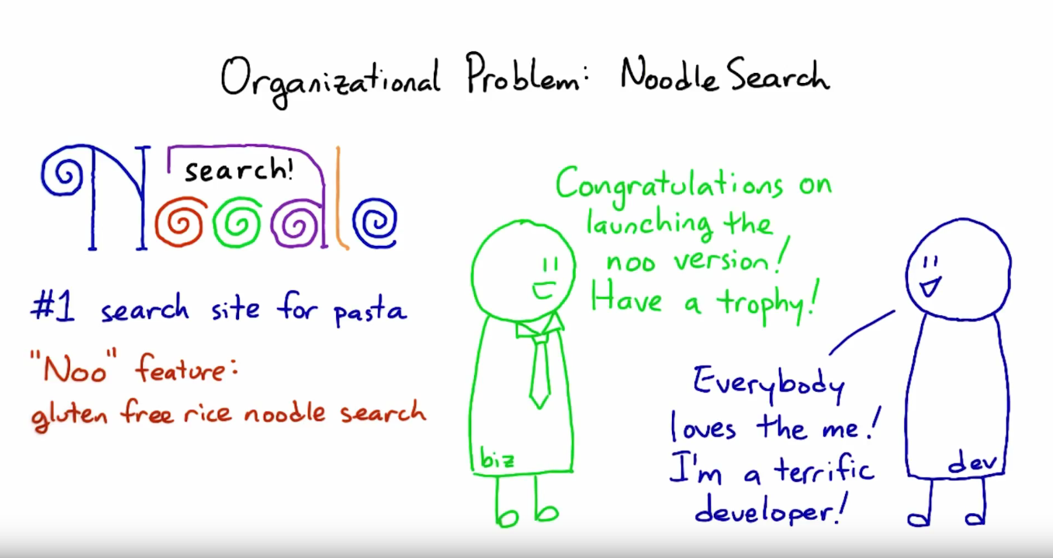
Notes:
1

Slide 33
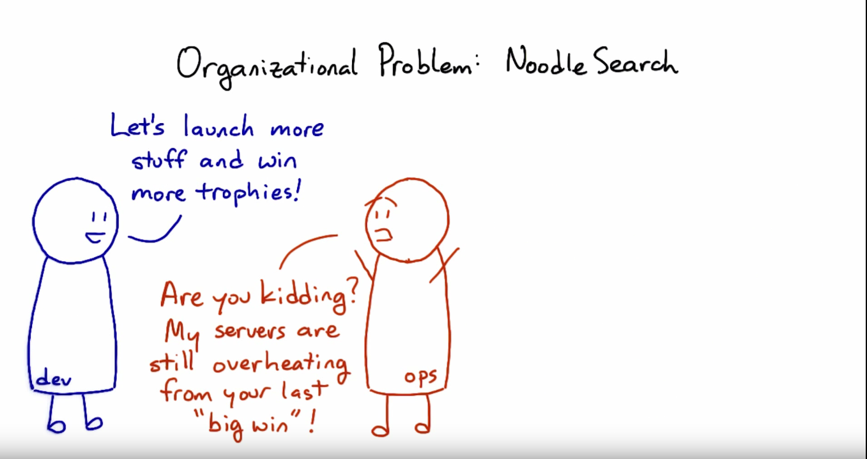
Notes:
1

Slide 34
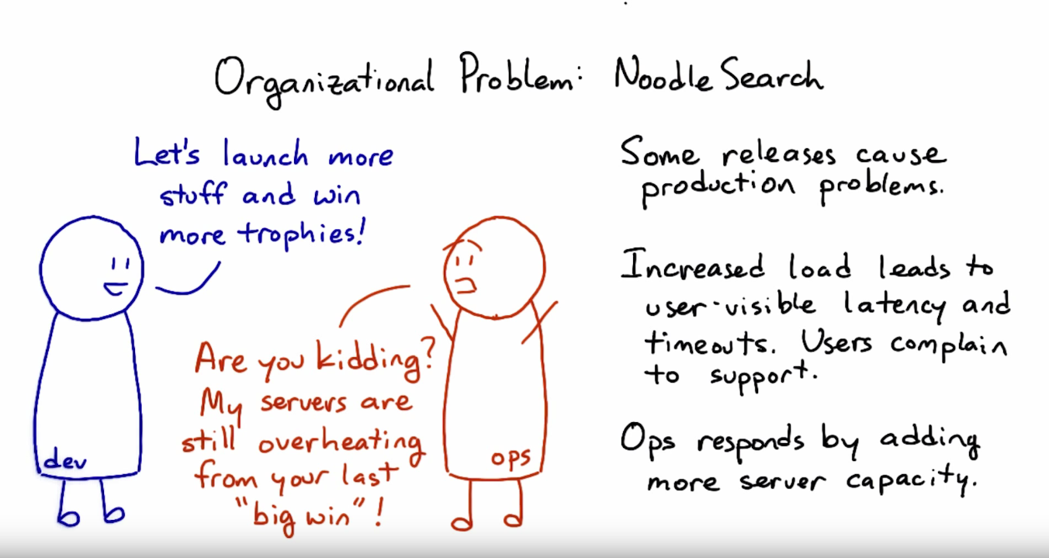
Notes:
1

Slide 35
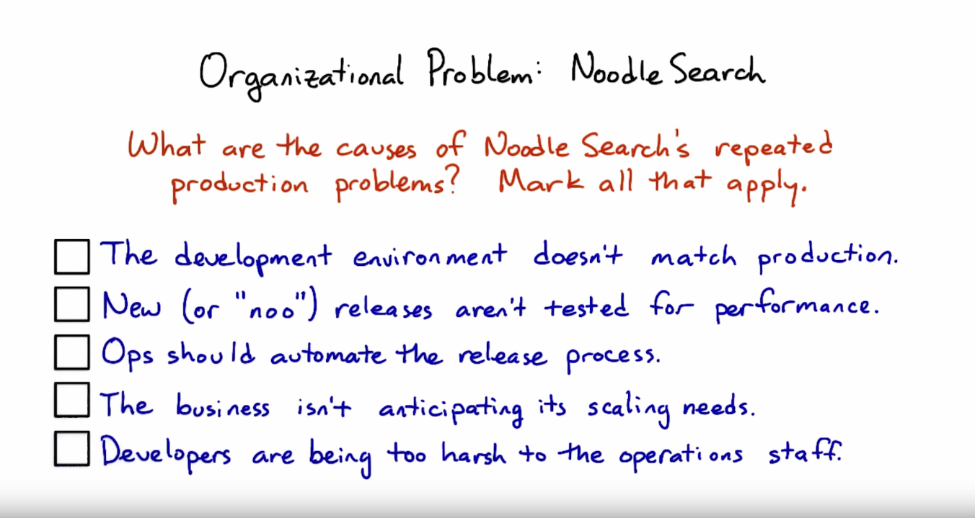
Notes:
1

Slide 36
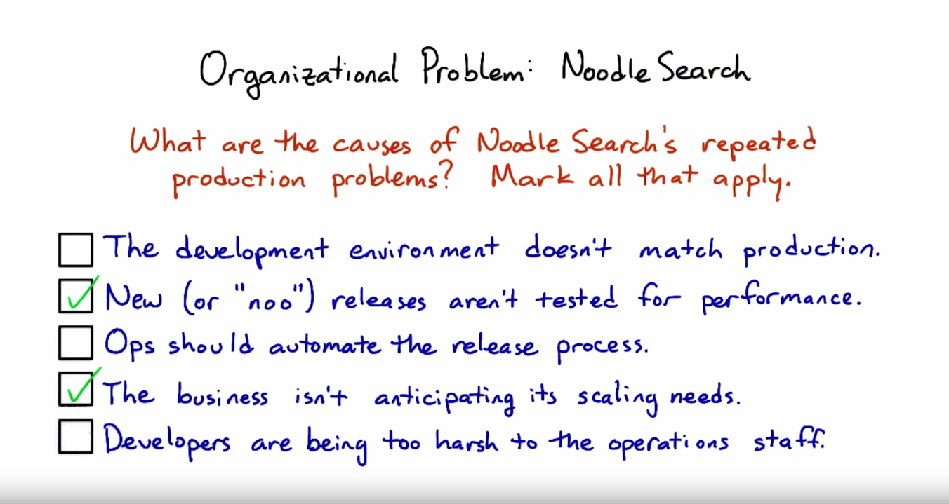
Notes:
1

Slide 37
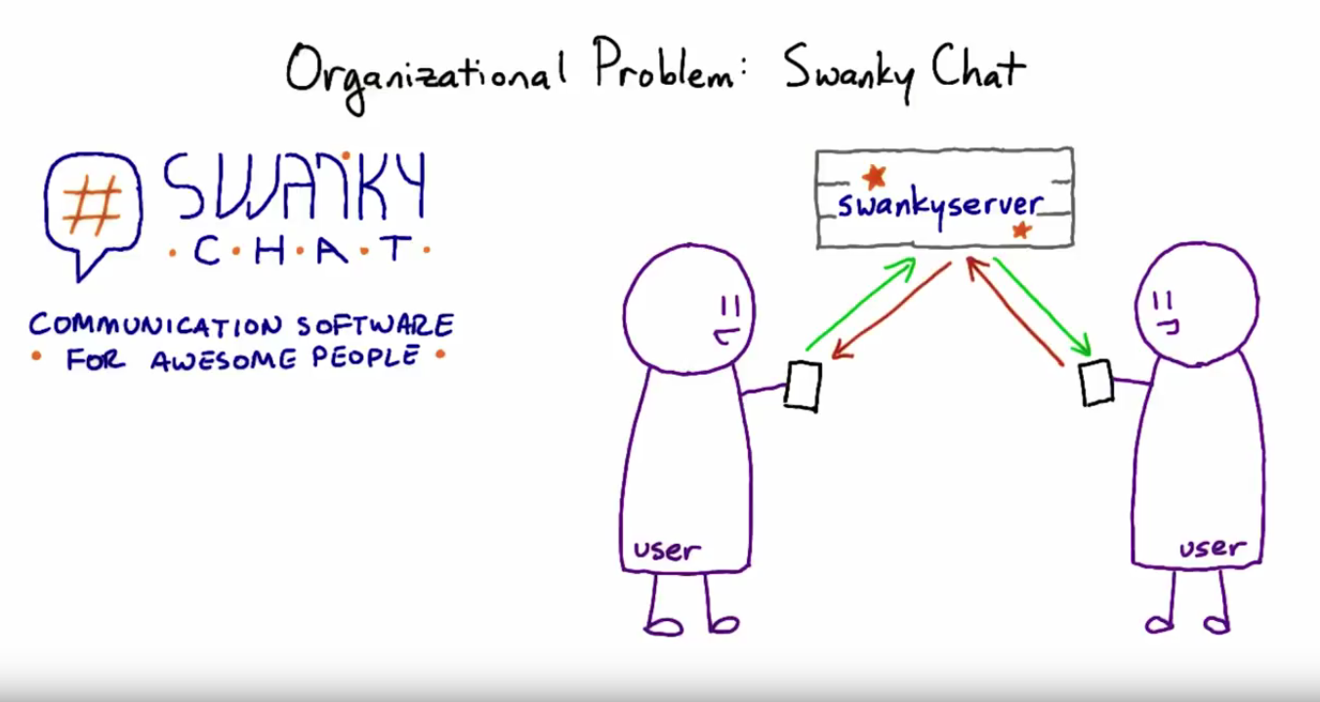
Notes:
1

Slide 38
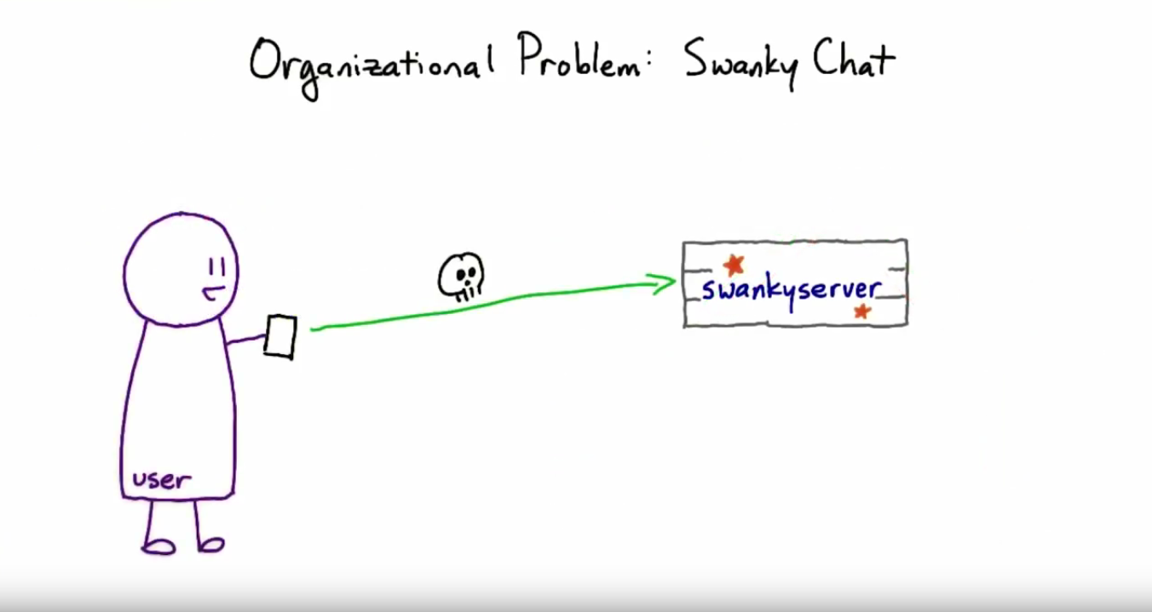
Notes:
1

Slide 39
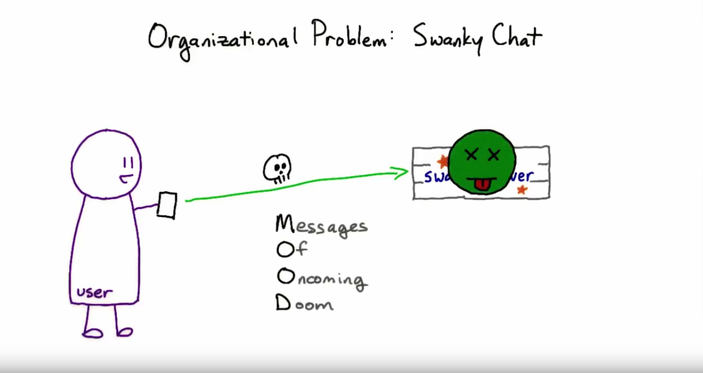
Notes:
1

Slide 40
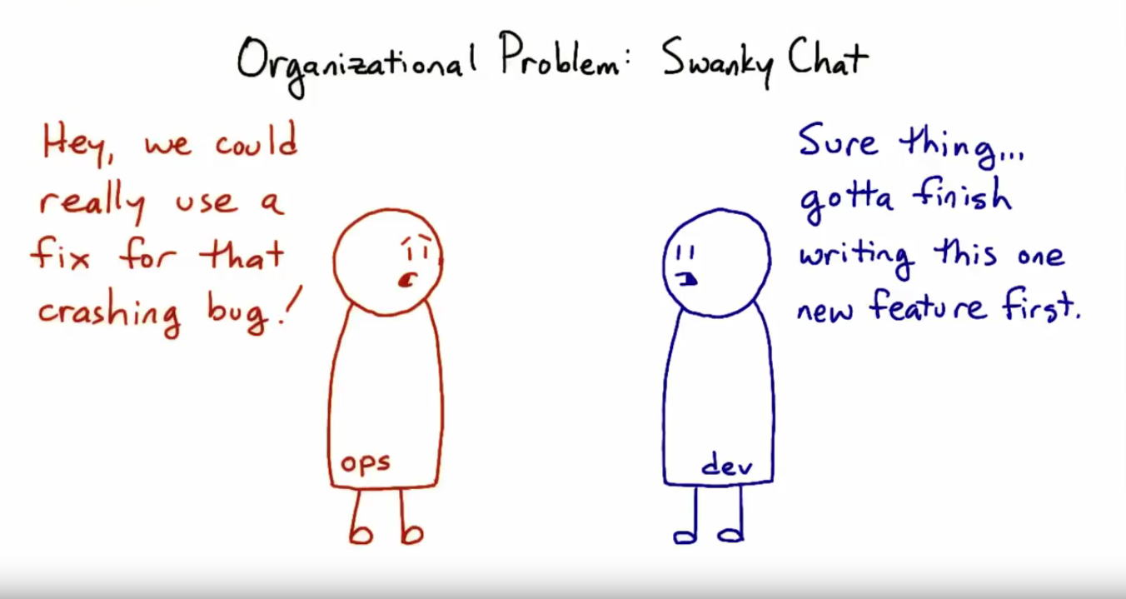
Notes:
1

Slide 41
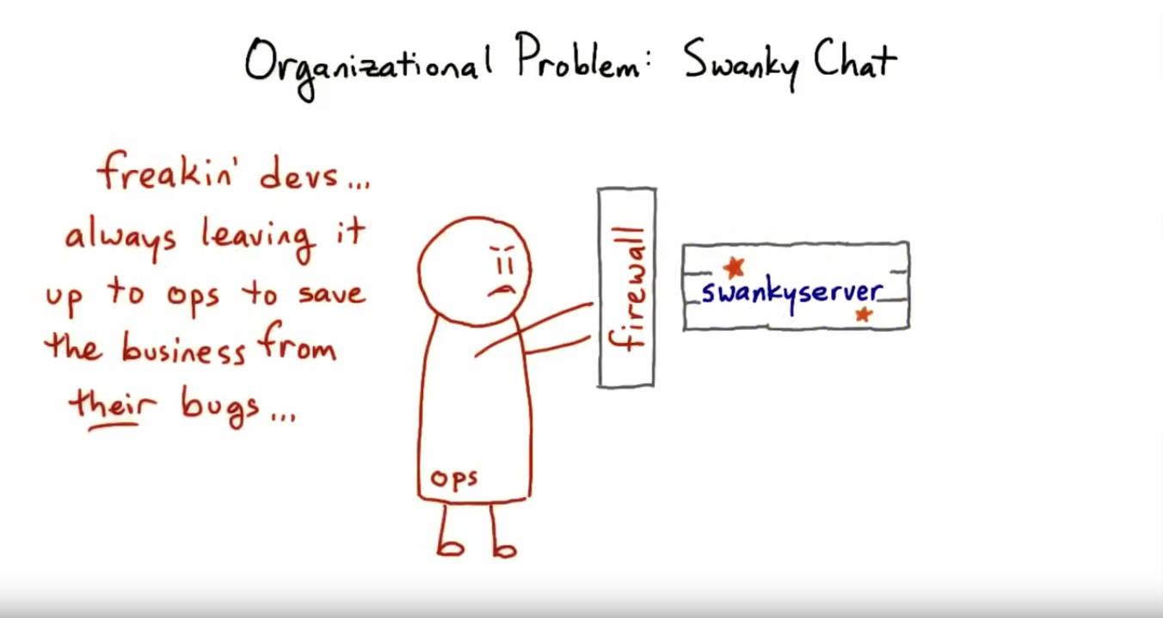
Notes:
1

Slide 42
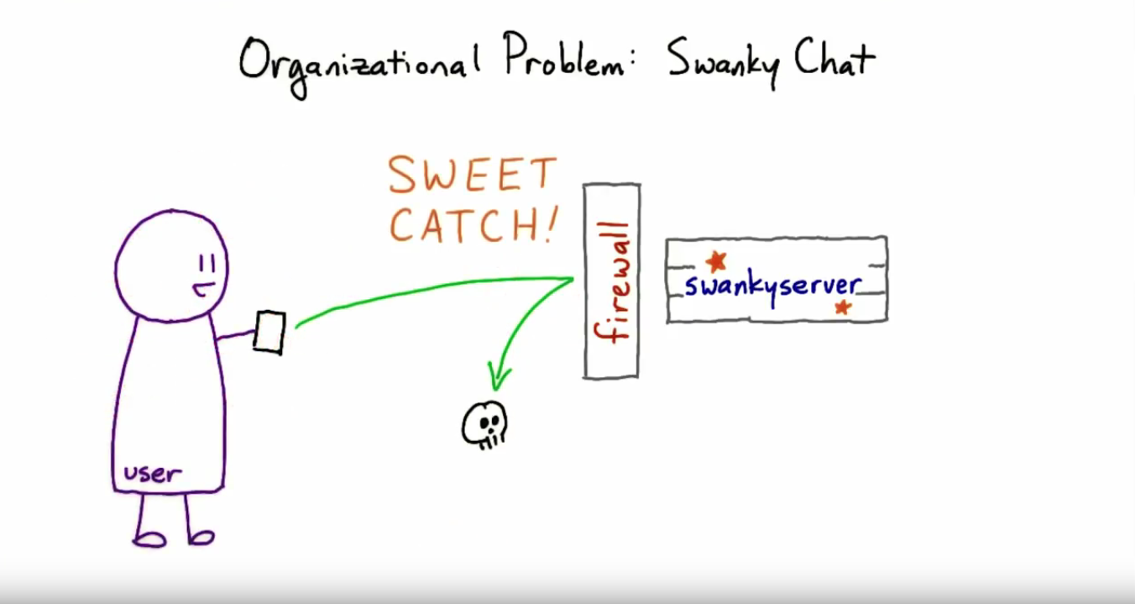
Notes:
1

Slide 43
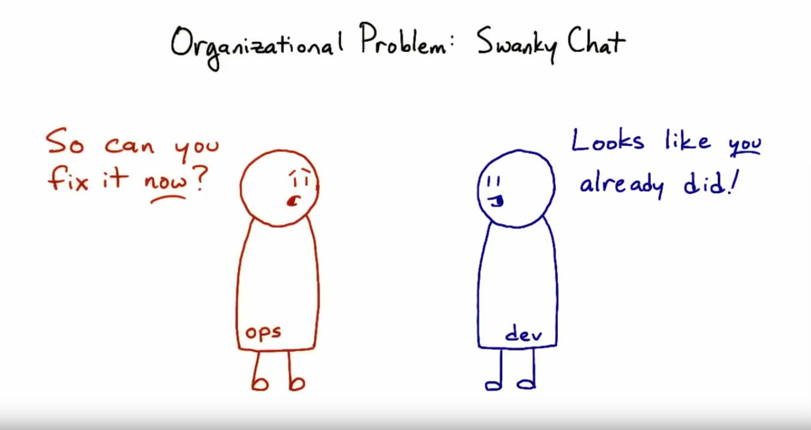
Notes:
1

Slide 44
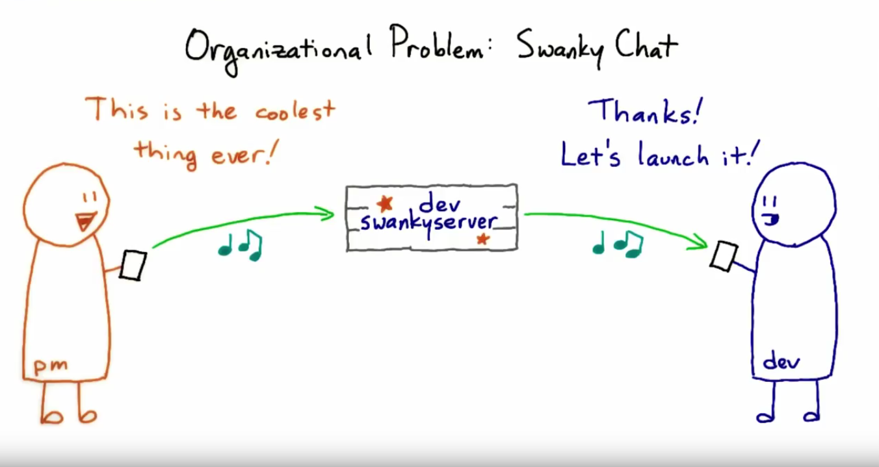
Notes:
1

Slide 45
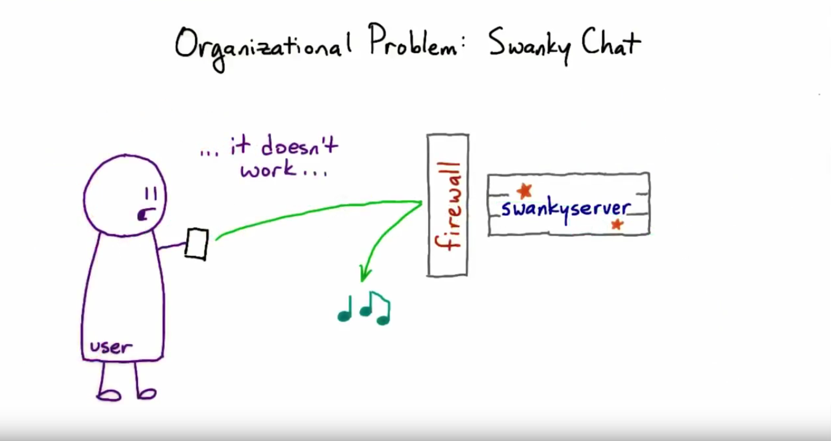
Notes:
1

Slide 46
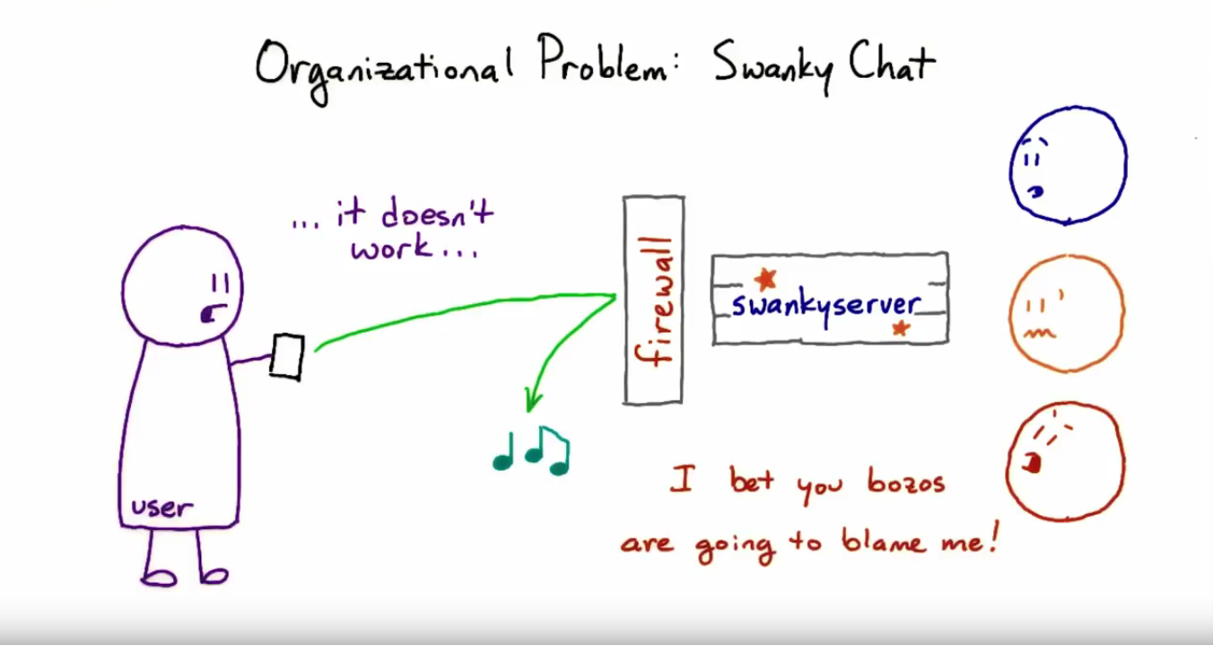
Notes:
1

Slide 47
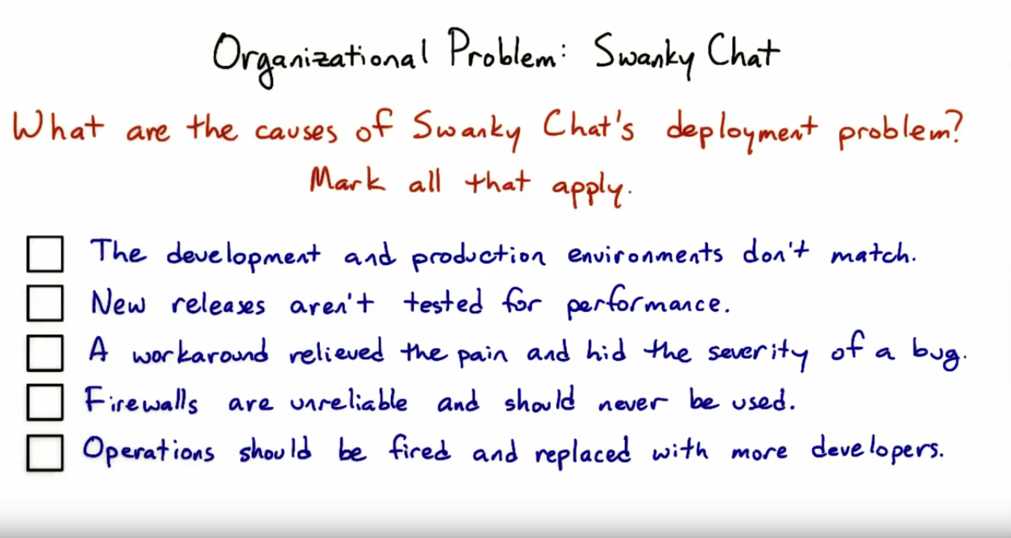
Notes:
1

Slide 48
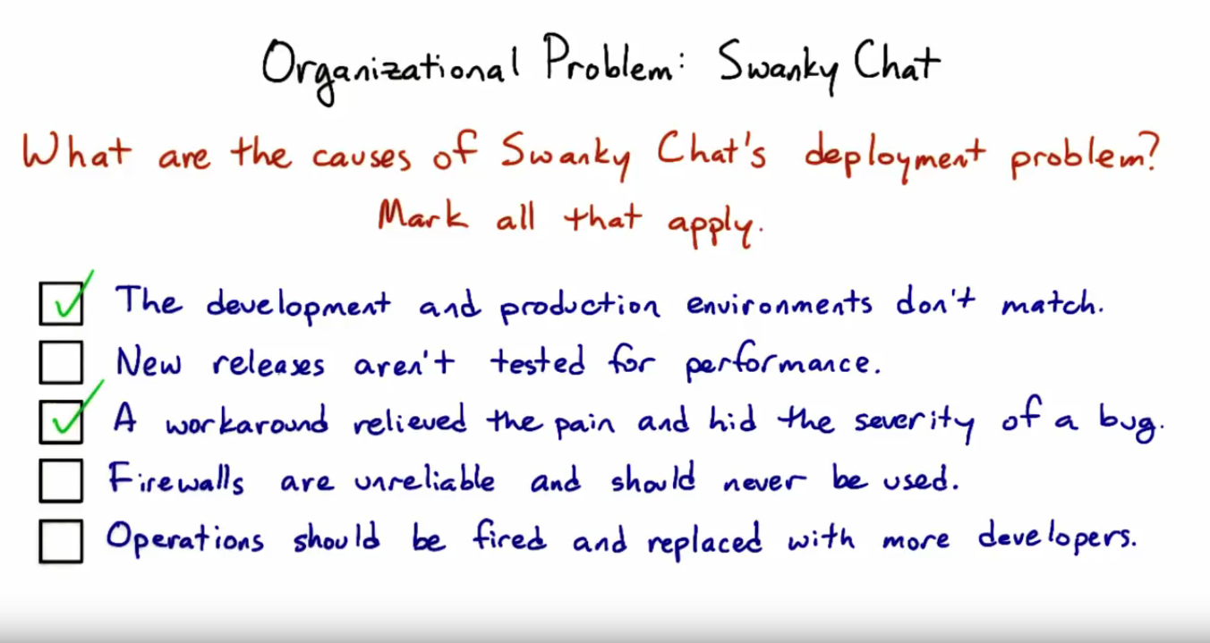
Notes:
1

Slide 49
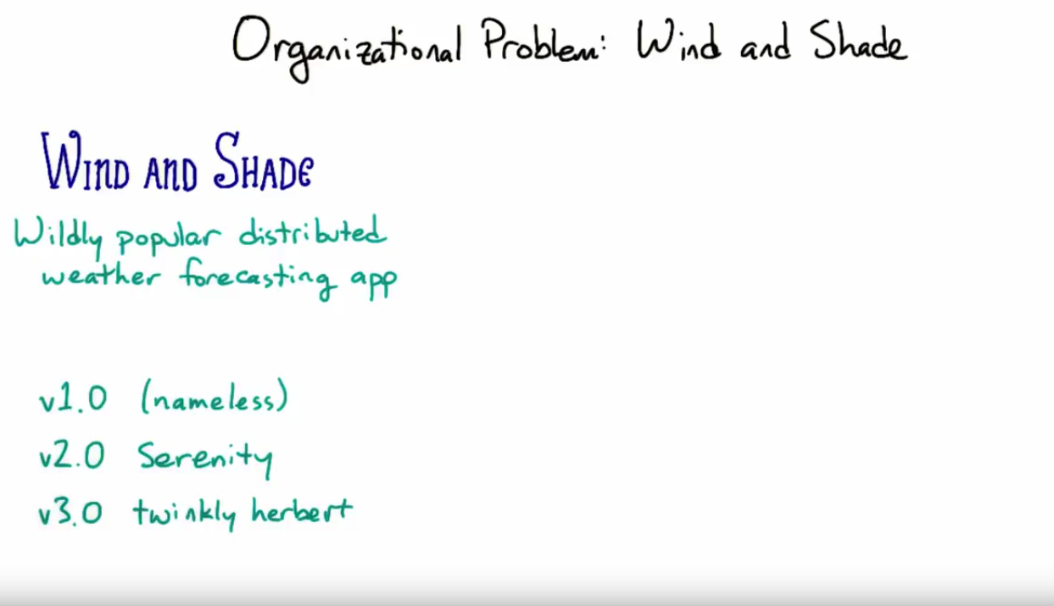
Notes:
1

Slide 50
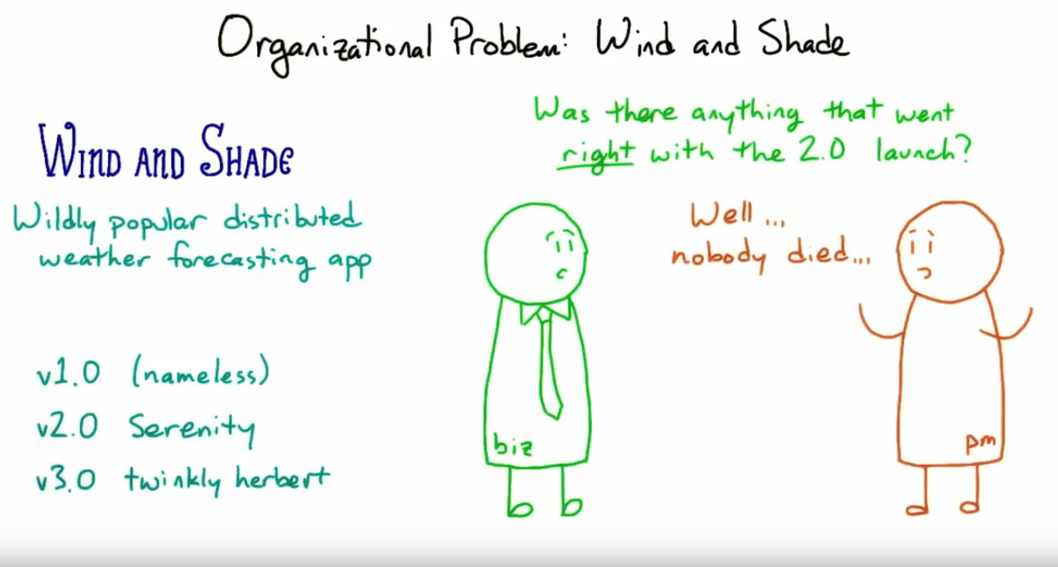
Notes:
1

Slide 51
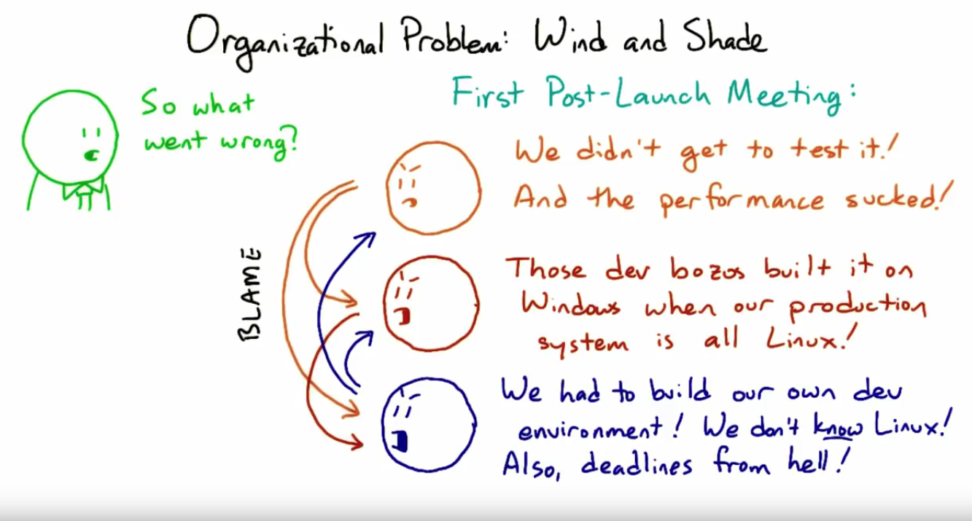
Notes:
1

Slide 52
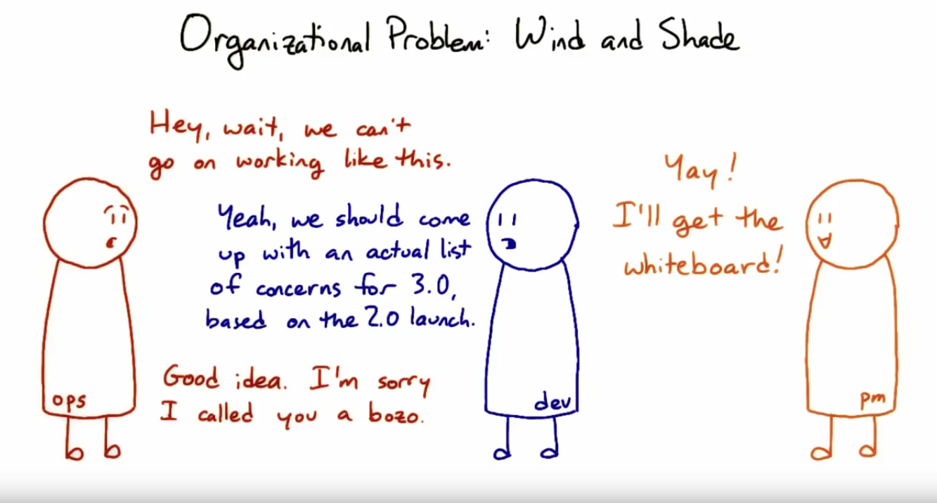
Notes:
1

Slide 53
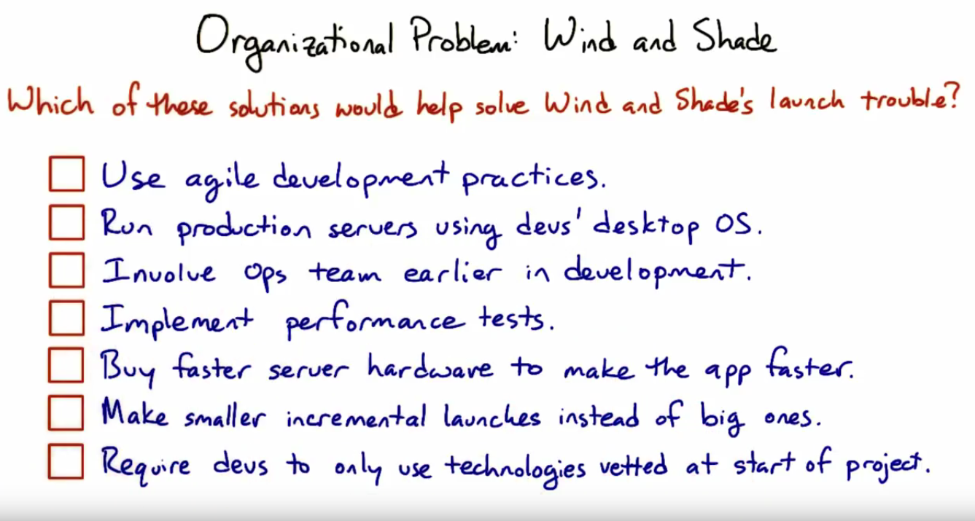
Notes:
1

Slide 54
Notes:
1

Slide 55
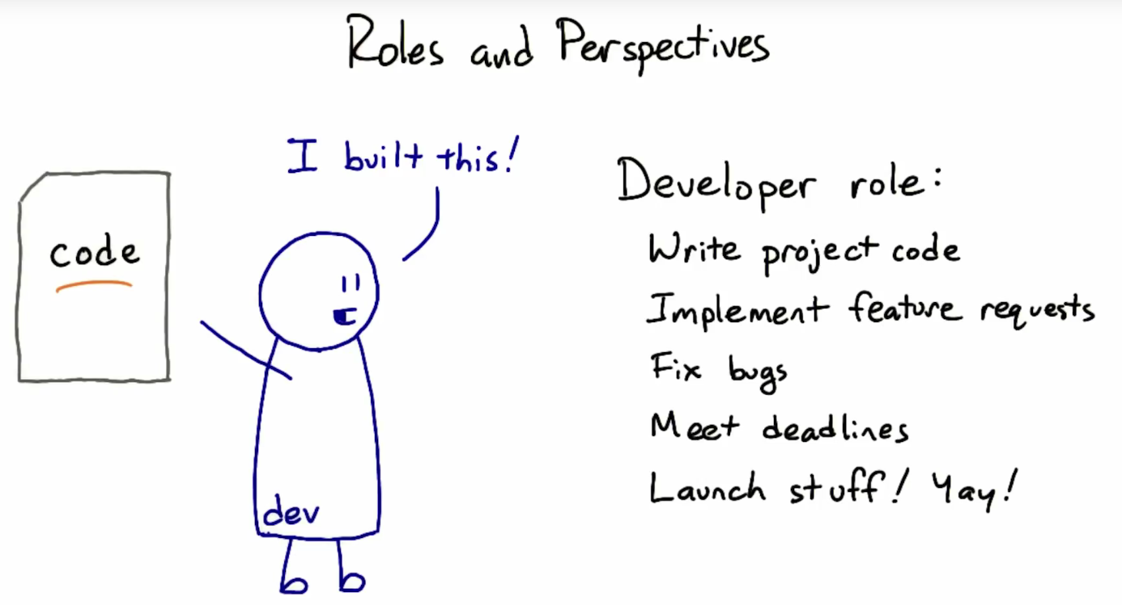
Notes:
1

Slide 56

Notes:
1

Slide 57

Notes:
1

Slide 58

Notes:
1

Slide 59

Notes:
1

Slide 60

Notes:
1

Slide 61

Notes:
1

Slide 62

Notes:
1

Slide 63

Notes:
1

Slide 64

Notes:
1

Slide 65

Notes:
1

Slide 66

Notes:
1

Slide 67

Notes:
1

